Slide 1




Topic: outsourcing
Lakshmi Narain College of Technology & science
EUREKA ID: EU24194545
Virtual
aid
Presented by:
ABHAY AGRAWAL (0157CS231005)​
ABHI JAIN (0157CS231009)​
HARSHITA MISHRA(0157CS231089)​
​

Slide 2

**YOUR PARTNER IN NEED
DO WHAT YOU DO BEST
WHILE WE HANDLE THE REST……….
**UNLOCK POTENTIAL FOR GROWTH

Slide 3
INTRODUCTION
COMPANY
OUTSOURCER
SERVICES
Outsourcing denotes the continuous procurement of services from a third party, making use of highly integrated processes, organization models and information systems.​
Engaging third – party vendors to handle specific business functions.

Slide 4

SEGMENTED BREAKDOWN AUDIENCE
Businesses that may not have the resources for large in-house teams.
Established companies looking to optimize operations.
New startups needing to manage costs while scaling quickly.
Non-Profit Organizations Groups that need to maximize impact while minimizing costs.
It is important to do segmentation.. because different audiences have different needs.. we will break them down.. so it will be easier to target.

Slide 5
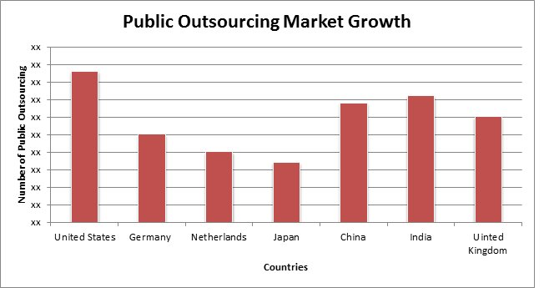
Strategies for Delivering Outsourcing Services
Conduct thorough assessments to understand your clients’ specific requirements, goals, and challenges.
Make clear communication about work, use email, video call to ensure transparency.
Continuously train your team to stay updated on industry trends and best practices. Well-trained employees deliver higher quality services and can adapt to changing client needs.
Build long-term relationships with clients based on trust and reliability. Regular check-ins and feedback sessions can strengthen these connections and enhance client loyalty.

Slide 6

REVENUE GENERATION
Service Fees: we will charge clients service fees for the tasks performed. These fees can be structured as fixed rates, hourly rates, or project-based pricing, providing a steady income stream , based on what type of work client want.
Volume-Based Pricing: Many outsourcing contracts are based on the volume of work completed. Higher volumes can lead to increased revenue for the outsourcer.
Long-Term Contracts: Securing long-term contracts with clients ensures consistent revenue over an extended period. These contracts often provide stability and predictability in cash flow
Some agreements include performance-based incentives, where outsourcers receive bonuses by completing your work with in time limits.

Slide 7

BENEFITS OF OUTSOUrCING TO CLIENT
Outsourcing can reduce operational costs, allowing companies to save on salaries, benefits, and overhead expenses.
outsourcing certain tasks, clients can focus on their primary business activities
Get work done fast, Outsourcing often leads to quicker completion of projects due to the specialized focus and resources of the provider.
Clients can easily scale services up or down based on their needs without the burden of hiring or laying off employee
Clients benefit from the latest tools and technologies that outsourcing partners may utilize, improving service quality without heavy investment.

Slide 8
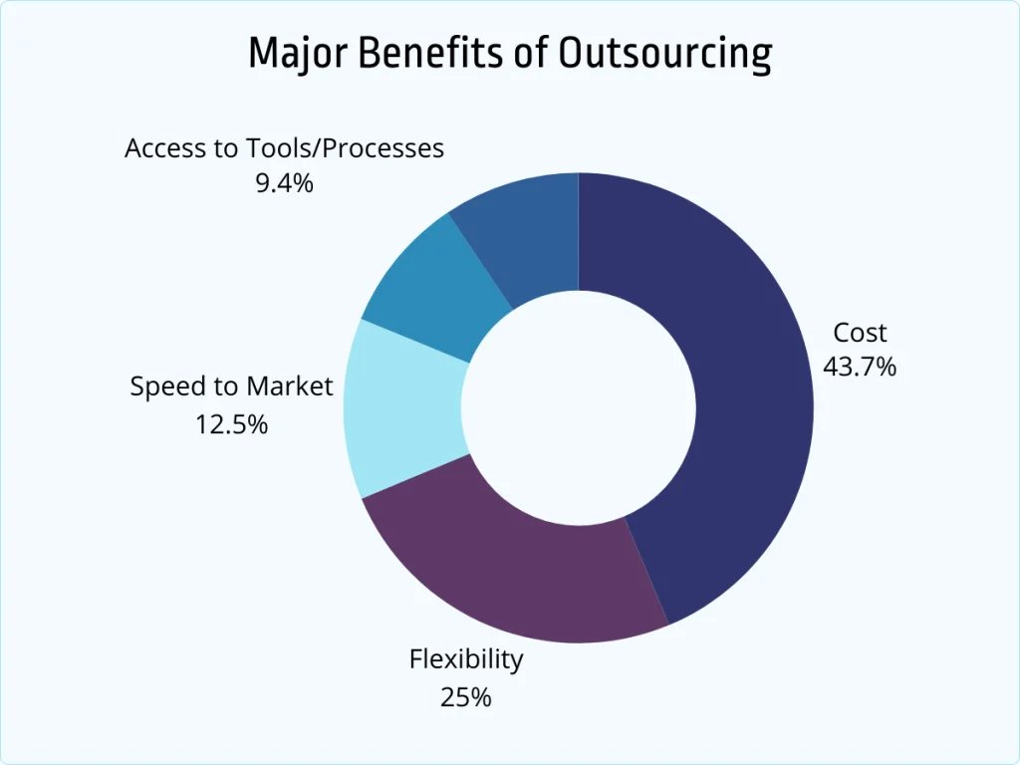
BENEFITS OF OUTSOUrCING TO SOCITY
Job Creation: Establishes new businesses and employment opportunities in developing region
Skill Development: Provides training and enhances workforce capabilities.
Access to Services: Improves availability of essential services in underserved communities.
Innovation and Competitiveness: Drives innovation by allowing focus on core activities.
Cost-Effective Solutions: Lowers operational costs, resulting in more affordable goods and services.

Slide 9
why my outsourcing service can stand out against competitors:
Expertise and Specialization: we will provide best service provider who has high skill in required field
Cutting-Edge Technology: Utilize the latest tools and technologies to enhance efficiency, quality, and security in service delivery.
Strong Communication: Maintain clear and consistent communication throughout the project lifecycle, ensuring alignment with client goals.

Slide 10
CONCLUSION
Effective outsourcing fosters improved customer service and satisfaction, which can lead to greater loyalty and business growth.
The flexibility that outsourcing offers allows organizations to scale operations quickly and respond to changing market demands.
Outsourcing has emerged as a powerful strategy for businesses seeking to enhance efficiency, reduce costs, and access specialized expertise.

Slide 11
Thank you

